Slide 1
Parallel Computing
Ekkapot Charoenwanit
Software Systems Engineering
TGGS
KMUTNB

Slide 2
Lecture 12:
Distributed-Memory Programming with MPI
Derived Datatypes

Slide 3
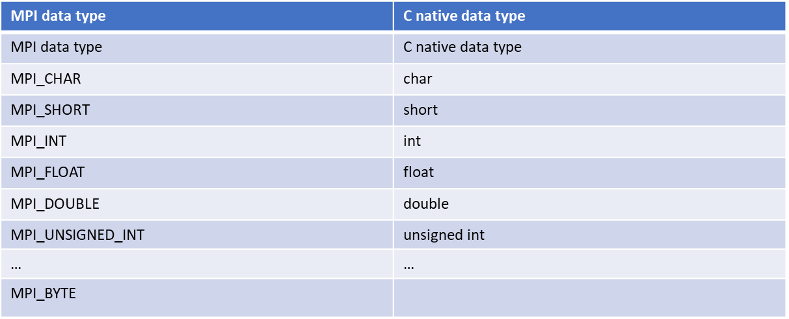
MPI: Datatype
MPI Datatypes are opaque objects called handles.
Used to interpret and access the contents of a memory buffer
MPI defines primitive datatypes that describe a single data element.
More complex datatypes can be derived from these primitive datatypes.

Slide 4
MPI: Datatype
We often want to exchange messages that
contain values with different datatypes such as a C struct
are non-contiguous such as a block of matrix elements
One naïve solution to sending non-contiguous data is by packing the non-contiguous data into a contiguous memory buffer at the sender and unpacking at the receiver.
This might require additional memory-to-memory copy operations at both sides.
Rather, MPI allows specifying more general, mixed-typed and non-continuous memory buffers.
It is up to the given MPI implementation to decide whether data should be first packed into a contiguous buffer before being transmitted or whether it can be collected directly from where the data is kept.

Slide 5
MPI: Type Signature and Type Map
A general datatype is a general object that describe two things as follows:
A sequence of basic datatypes
A sequence of byte displacements
The type signature of a datatype is a sequence of datatypes described by a given type and count:
e.g., {MPI_INT, MPI_INT, MPI_DOUBLE}, which describes the datatype as a sequence of two integers followed by one double.
The type map of a datatype is a sequence of basic datatypes and their displacements
e.g., {(MPI_INT,0),(MPI_INT,4),(MPI_DOUBLE,8)}
Datatypes are local objects:
They may differ across MPI processes
Each process performs the marshalling and unmarshaling of messages in a transparent manner.

Slide 6
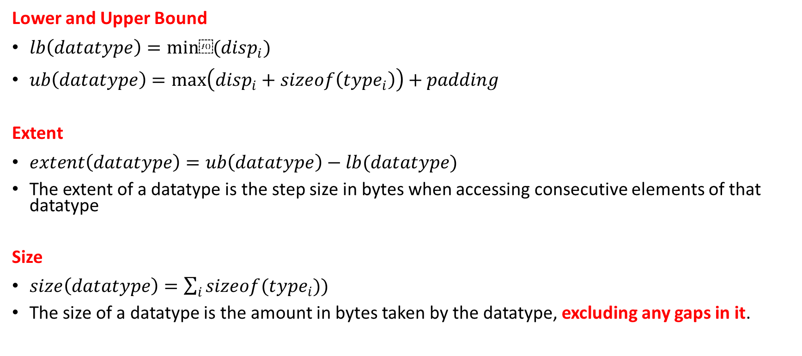
MPI: Terminology
Lower and Upper Bound
$lb\left(datatype\right)=min⁡(disp_{i})$
$ub\left(datatype\right)=max\left(disp_{i}+sizeof\left(type_{i}\right)\right)+padding$
Extent
$extent\left(datatype\right)=ub\left(datatype\right)−lb(datatype)$
The extent of a datatype is the step size in bytes when accessing consecutive elements of that datatype
Size
$size\left(datatype\right)=\sum_{i}{sizeof(type_{i}}))$
The size of a datatype is the amount in bytes taken by the datatype, excluding any gaps in it.

Slide 7
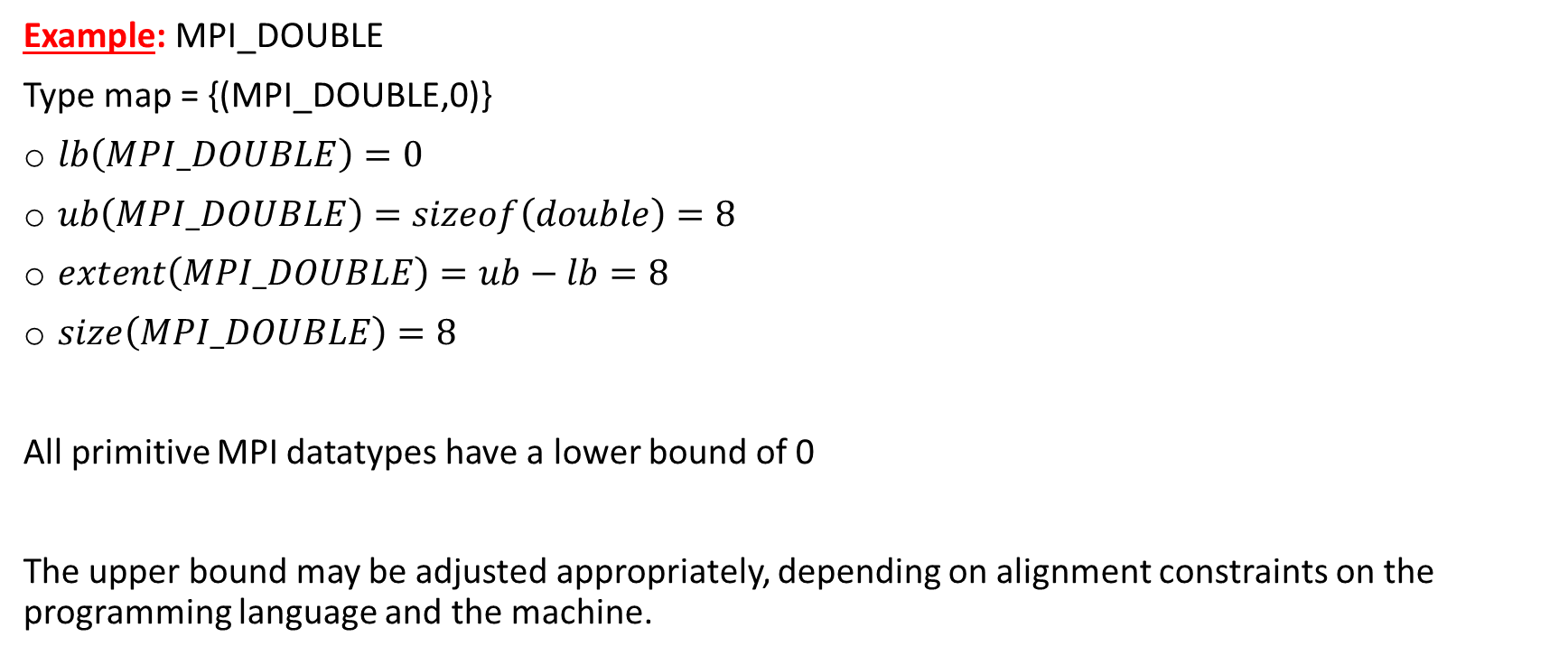
MPI: Basic Datatype
Example: MPI_DOUBLE
Type map = {(MPI_DOUBLE,0)}
$lb\left(MPI_DOUBLE\right)=0$
$ub\left(MPI_DOUBLE\right)=sizeof\left(double\right)=8$
$extent\left(MPI_DOUBLE\right)=ub−lb=8$
$size\left(MPI_DOUBLE\right)=8$
All primitive MPI datatypes have a lower bound of 0
The upper bound may be adjusted appropriately, depending on alignment constraints on the programming language and the machine.

Slide 8
MPI: What it looks like in action
Extent of newType
Extent of newType
sbuff
MPI_Send( sbuff , 2 , newType , dest , tag , MPI_COMM comm )
2x size of newType
message
MPI_Recv( rbuff , 2 , newType , src , tag , MPI_COMM comm , &status)
rbuff

Slide 9
MPI: Contiguous Datatypes
Create a sequence of elements of an existing datatype
The new datatype newType represents a contiguous sequence of count elements of oldType.
The elements (of newType) are separated from each other by the extent of oldType.
Useful for sending entire rows (C/C++) or columns (Fortran) of matrices
C
MPI_ Type_contiguous( int count , MPI_Datatype oldType , MPI_DataType * newType)

Slide 10
MPI: Vector Datatypes
Create a sequence of equally spaced blocks of elements of an existing datatype
The new datatype newType represents a sequence of count blocks, each of which contains blockLen elements of oldType.
Every two consecutive blocks are separated by stride elements of oldType.
C
MPI_ Type_vector( int count , int blockLen , int stride , MPI_DataType oldType , MPI_Datatype * newType)
blockLen=2
stride=3
count=3

Slide 11
MPI: Vector Datatypes
Example: one column of a C/C++ matrix with 4 rows and 6 columns
mat[4][6]
stride=6
&mat[0][0]
count=4
blockLen=1

Slide 12
MPI: Vector Datatypes
Example: one column of a C/C++ matrix with 4 rows and 6 columns
mat[4][6]
stride=6
&mat[0][2]
count=4
blockLen=1

Slide 13
MPI: Vector Datatypes
Example: two columns of a C/C++ matrix with 4 rows and 6 columns
mat[4][6]
stride=6
&mat[0][0]
count=4
blockLen=2

Slide 14
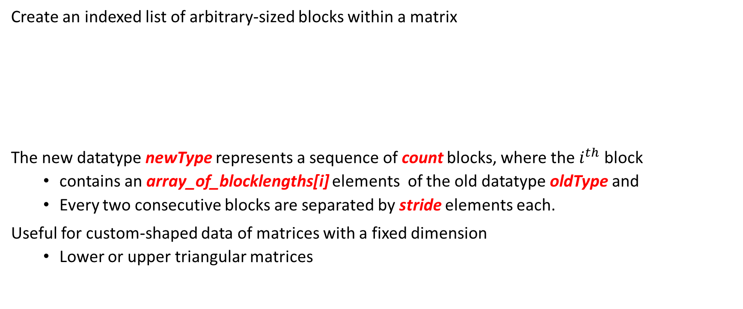
MPI: Indexed Datatypes
Create an indexed list of arbitrary-sized blocks within a matrix
The new datatype newType represents a sequence of count blocks, where the $i^{th}$ block
contains an array_of_blocklengths[i] elements of the old datatype oldType and
Every two consecutive blocks are separated by stride elements each.
Useful for custom-shaped data of matrices with a fixed dimension
Lower or upper triangular matrices
C
MPI_ Type_indexed( int count , const int array_of_blocklengths [] , const int array_of_displacements [] ,
MPI_DataType oldType , MPI_Datatype * newType)

Slide 15
MPI: Indexed Datatypes
Example: lower triangle of a matrix of dimension 5 x 5
mat[4][6]
count=4
array_of_ displacements=[5,10,15,20]
array_of_blocklengths = [0,1,2,3,4]

Slide 16
MPI: Structure Datatypes
The most generic datatype constructor
Useful for C/C++ structures
count: the number of blocks in the datatype
array_of_blocklengths: the number of elements in each block
array_of_displacements: the displacement in bytes from the start of each block
array_of_types: the datatype of the elements in each block
newType: handle of the new datatype
C
MPI_ Type_create_struct( int count , const int array_of_blocklengths [] ,
const int array_of_displacements [] ,
const int array_of_types [],
MPI_Datatype * newType
)

Slide 17
MPI: Structure Datatypes
displs[0]
displs[1]
displs[2]
displs[3]
blens[0]
blens[1]
blens[2]
blens[3]
buffer
types[0]
types[1]
types[2]
types[3]

Slide 18
MPI: Structure Datatypes
typedef struct{
float mass;
double pos[3];
char sym;
}Particle;
int blens = { 1 , 3 , 1 } ;
MPI_Aint displs [3] = { offsetof(Particle,mass} , offsetof(Particle,pos) , offsetof(Particle,sym)};
MPI_Datatype types[3] = { MPI_FLOAT , MPI_DOUBLE , MPI_CHAR };
MPI_Datatype particleType;
MPI_Type_create_struct( 3 , blens , displs , types , &particleType );
typedef struct{
float mass;
double pos[3];
char sym;
}Particle;
int blens = { 1 , 3 , 1 } ;
MPI_Aint displs [3] = { offsetof(Particle,mass} , offsetof(Particle,pos) , offsetof(Particle,sym)};
MPI_Datatype types[3] = { MPI_FLOAT , MPI_DOUBLE , MPI_CHAR };
MPI_Datatype particleType;
MPI_Type_create_struct( 3 , blens , displs , types , &particleType );

Slide 19
MPI: Registering Derived Datatypes
Register a derived datatype for using with communication operations
Datatypes need to be committed before they can be used in communication operations.
All primitive datatypes, e.g., MPI_INT, MPI_FLOAT etc., are already committed.
Intermediate datatypes defined by the user that are used to implement more complex datatypes but are not used in communication operations can be left uncommitted.
C
MPI_ Type_ commit( MPI_Datatype * newType)

Slide 20
MPI: Registering Derived Datatypes
Deregister and free up a derived datatype
Derived datatypes that were previously derived from the freed datatype are unaffected.
Upon a successful return, datatype is set to MPI_TYPE_NULL.
C
MPI_ Type_ free( MPI_Datatype * datatype)

Slide 21
MPI: Structure Datatypes
typedef struct{
float mass;
double pos[3];
char sym;
}Particle;
int blens = { 1 , 3 , 1 } ;
MPI_Aint displs [3] = { offsetof(Particle,mass} , offsetof(Particle,pos) , offsetof(Particle,sym)};
MPI_Datatype types[3] = { MPI_FLOAT , MPI_DOUBLE , MPI_CHAR };
MPI_Datatype particleType;
MPI_Type_create_struct( 3 , blens , displs , types , &particleType );
MPI_Type_commit(&particleType); //Here we commit the new datatype

Slide 22

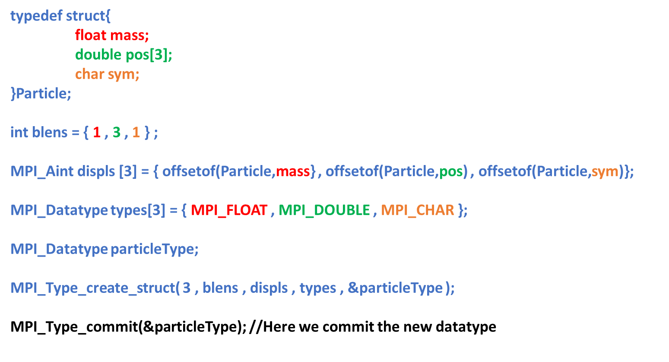
MPI: Structure Datatypes
The handle particleType can now be used to send and receive ONE element of Particle.

Slide 23
MPI: Structure Datatypes
We need to resize to the actual size of the structure.
typedef struct{
float mass;
double pos[3];
char sym;
}Particle;
int blens = { 1 , 3 , 1 } ;
MPI_Aint displs [3] = { offsetof(Particle,mass} , offsetof(Particle,pos) , offsetof(Particle,sym)};
MPI_Datatype types[3] = { MPI_FLOAT , MPI_DOUBLE , MPI_CHAR };
MPI_Datatype intermediateType;
MPI_Type_create_struct( 3 , blens , displs , types , &intermediateType );
MPI_Aint true_extent = sizeof(Particle);
MPI_Type_create_resized(intermediateType,0,true_extent,&particleType);
MPI_Type_commit(&particleType);
Note that there is no need to commit the intermediate type unless it will be used in communication operations.

Slide 24
References
[1] William Gropp, Ewing Lusk, and Anthony Skjellum. 2014. Using MPI: Portable Parallel Programming with the Message-Passing Interface. The MIT Press.
[2] Marc-Andre Hermanns. 2021. MPI in Small Bites. PPCES 2021.

